Slide 1
IOT PROJECT
Face Recognition Ai Robot Using Raspberry Pi

Slide 2
Prepared by
Suraj Garg
Chirag Varshney
Ankit Kumar
Ishant Goyal
Under the guidance of
Mr. Amir Khan Sir

Slide 3
Objective
To detect and recognize the faces from image files from Raspberry Pi.

Slide 4
Application Area
Attendance using face detection.
Home Security
Business Security
Hospital Monitoring System

Slide 5
Introduction
Traditionally attendance is marked manually by teachers and they must make sure correct attendance is marked for respective student.
This whole process wastes some of lecture time and part of correct information is missed due to fraudulent and proxy cases.
In order to determine classroom attendance, face detection and face recognition are performed. Face detection is used to determine the location of the faces in the classroom image and extract sub images for each face. Then, in face recognition, the face images detected will be compared with the data base consisting of images of students in the class, and attendance will be recorded accordingly.

Slide 6
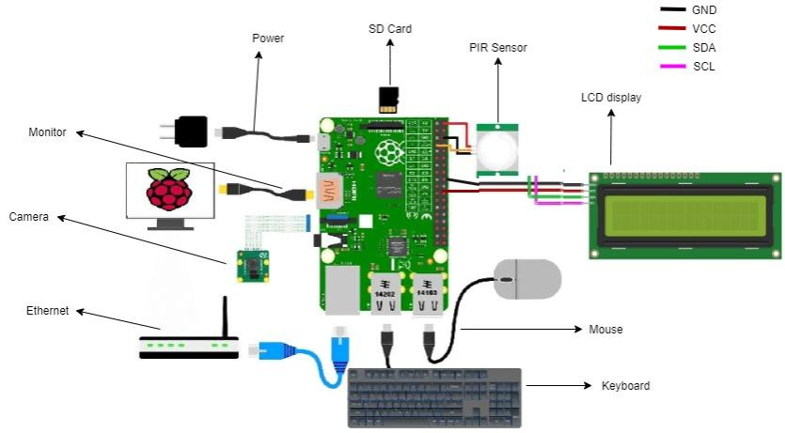
Project Layout

Slide 7
Significance
Automated
Economically
Effective
Keep extra time

Slide 8
Components Requirements
Raspberry Pi 3 Model B
Raspberry Pi Camera Module V2
16x2 LCD I2C Display
HC-SR501 PIR Sensor
Micro SD Card with Raspbian pre-installed

Slide 9
Raspberry Pi
Raspberry Pi is a series of small single-board computers developed in the United Kingdom by the Raspberry Pi Foundation in association with Broadcom. Early on, the Raspberry Pi project leaned towards the promotion of teaching basic computer science in schools and in developing countries. Later, the original model became far more popular than anticipated, selling outside its target market for uses such as robotics. It is now widely used in many areas, such as for weather monitoring, because of its low cost, modularity, and open design.

Slide 10
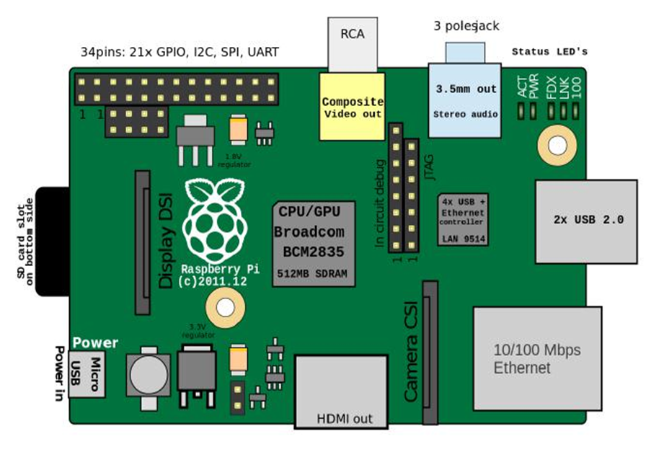
Layout of Raspberry Pi 3 Model B

Slide 11
Raspberry Pi Camera
The Raspberry Pi camera module is a portable light weight camera that supports Raspberry Pi. It communicates with Pi using the MIPI camera serial interface protocol. It is normally used in image processing, machine learning or in surveillance projects.

Slide 12
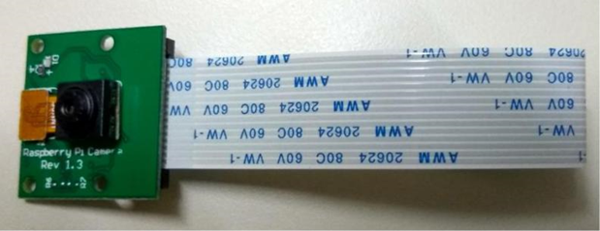
Raspberry Pi Camera Module V2

Slide 13
Raspbian
Raspberry Pi OS (formerly Raspbian) is a Debian-based operating system for Raspberry Pi. Since 2015 it has been officially provided by the Raspberry Pi Foundation as the primary operating system for the Raspberry Pi family of compact single-board computers.

Slide 14
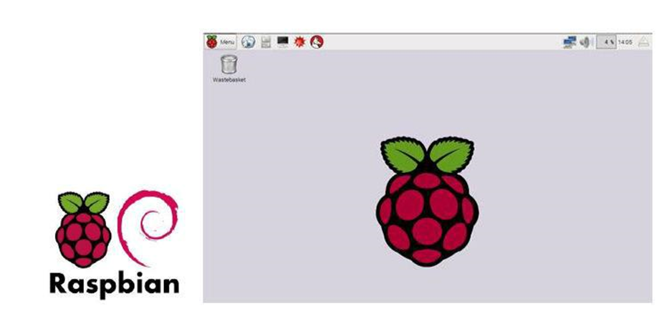
Logo and Desktop interface of Raspbian

Slide 15
PIR sensor
A passive infrared sensor (PIR sensor) is an electronic sensor that measures infrared (IR) light radiating from objects in its field of view. They are most often used in PIR-based motion detectors. PIR sensors are commonly used in security alarms and automatic lighting applications.

Slide 16
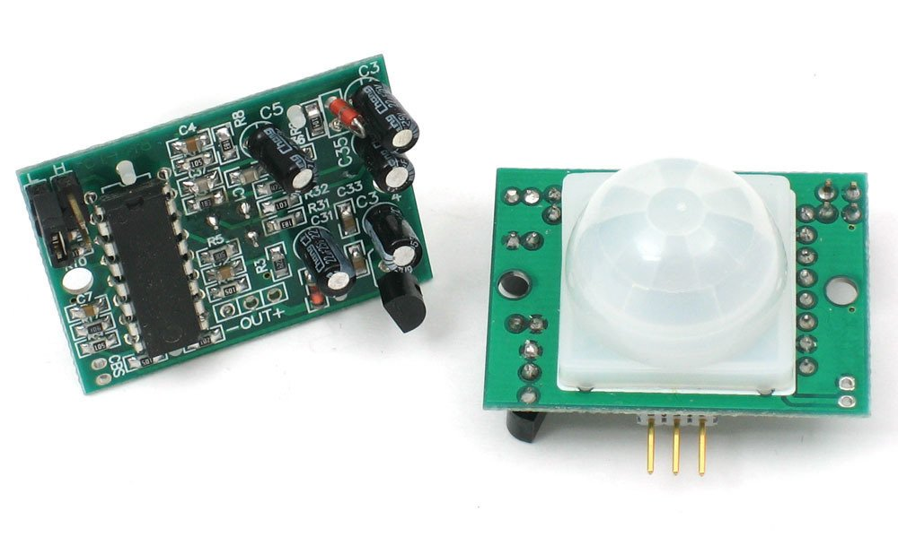
HC-SR501 PIR Sensor

Slide 17
WORKING PRINCIPLE
First we Captures 10 images of 10 different person with the help of Pi camera module.
The images of each subject is stored in specific directory with 30 images .
Each image size is of about 100x130pixels.
The viola Jones detection algorithm is used for face detection whereas
PCA algorithm is used for feature extraction and
then Adaboost classifier is used for face recognition.

Slide 18
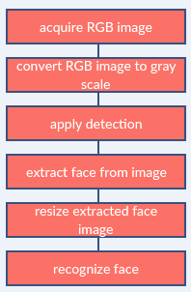
Image processing

Slide 19
Face Detection
Face detection is a computer technology used to identify human faces in digital images by determining the location of the faces in the image and extract sub images for each face.
Viola Jones algorithm will be implemented to recognize face and non-face patterns and enable us to identify locations of the faces in the image.

Slide 20
How Do We Create Database
Database is the collection of face images and extracted features. And the database includes names of students & registration number for each student .
We created a data base for 18 persons, were we took 10 images per person using raspberry pi model 2 cam, these images were taken at different times and with variations in illumination, facial expressions, and facial details.

Slide 21
CONCLUSION
This IOT based project is the fruit of continuous work of our Team. We use python language, xml and shell scripting language for further development of this project. Raspberry pi model 3 helps for Faster response, CameraV2 module used for capturing images and store in bucket then using viola jones detection algorithm and PCA algorithm for face Recognition.

Slide 22
Future work
Automatic attendance system can be improved by increasing the number of features which can be extracted to increase accuracy of face recognition. Once the software is developed and tested properly, it could be improved to cover full institutions such as the faculty of engineering.

Slide 23


